Slide 1
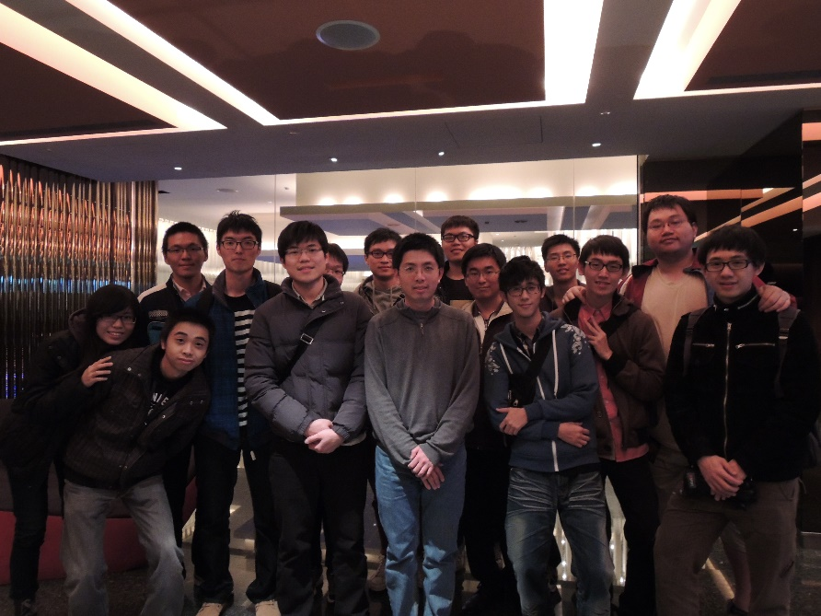
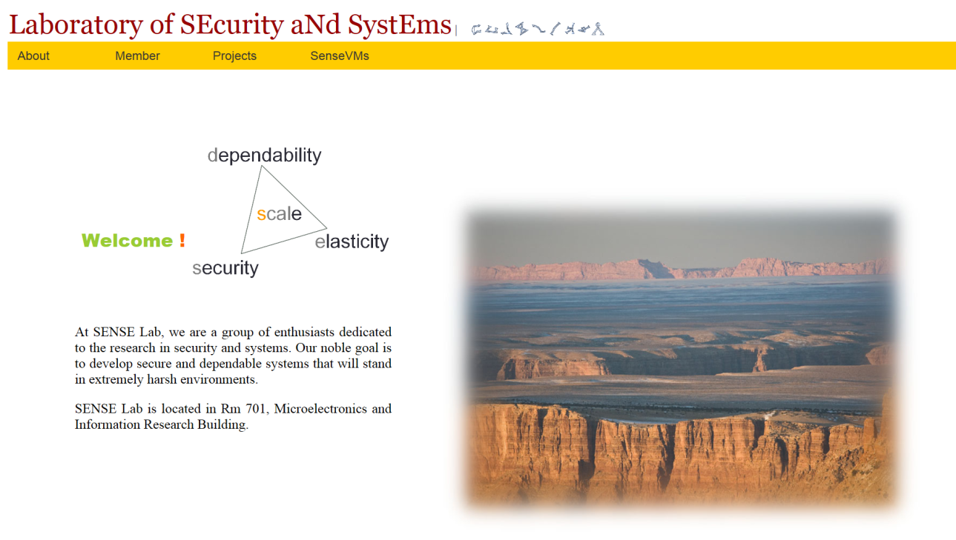
Research Interests: Security, Dependability, and Systems
Yu-Sung Wu received B.S. in electrical engineering from National Tsing Hua University, Hsinchu, Taiwan in 2002, M.S. and Ph.D. in electrical and computer engineering from Purdue University, West Lafayette, Indiana in 2004 and 2009.
In 2009, he joined National Chiao Tung University in Hsinchu, Taiwan, where he is currently an assistant professor of the computer science department. Previously, he had worked at Purdue CERIAS research center conducting research on the design of automated response system for distributed applications. Over the summers, he had also worked at Avaya Labs in New Jersey developing prototypes of intrusion detection system for VoIP environment.
Prof. Yu-Sung Wu is a member of IEEE and ACM. He had served on the program committees of several conferences including DSN, ICDCS, WRAITS, and SERE

